Slide 1
Brew Your Money?
Theodore Tay
DSI 3 – Capstone Presentation

Slide 2
Aim
Placed a
Term Deposit
Marketing
Campaign
Customer behavioural insights
Did not place
a Term Deposit
Notes:
The aim of my project is to be able to formulate a classification model that will accurately…

Slide 3
Rationale
Improve workplace efficiency
Campaign success rate
Boost
customer satisfaction
1
2
3

Slide 4
Workflow
Step 1
Preliminary
Modelling
Step 2
Re-sampling
Feature selection
Step 3
Actual
Modelling
K-nearest neighbours
Logistic regression
SMOTEENN
Select K Best
Lasso regularisation
Recursive feature elimination
Logistic regression
Support Vector Machine
Decision Tree Classifiers
Gradient Boosting
(All with tuning)
Step 4
Test on
unseen data
Step 5
Reduce
false negatives

Slide 5
Model of choice: Gradient Boosting
Final Model
Model n^{th}
Model …
Model 2
Model 1
Dataset
Notes:
1st Reason: It is a very robust model in the sense that it is not just a stand alone model. It is one which many base models are built sequentially, with each making an attempt to reduce the error from the previous one – resulting in the final model.

Slide 6
Model of choice: Gradient Boosting
Models | Test Set Accuracy Score | F1 Score | ROC-AUC
Baseline Accuracy |  | 0.538
Logistic Regression (with tuning) | 0.837 | 0.86 | 0.871
Support Vector Machine | 0.847 | 0.87 | 0.865
Decision Tree Classifier (with tuning) | 0.866 | 0.88 | 0.830
Gradient Boosting | 0.865 | 0.88 | 0.871

Slide 7

Limitations
Dataset did not contain:
Demographics
Annual salary of customers
Current housing or personal loans
Text summary of calls
Notes:
The dataset did not contain “annual salary of customers”. I feel that this could be a very key indicator of their capacity to subscribe to a term deposit.
This may provide information on whether those living in social isolation may have a greater appreciate for telemarketing.

Slide 8
Thank you
I hope you enjoyed the presentation.

Slide 9

Features of interest?
Employee variability rate
Duration of phone call
Previous participation in a campaign
Success of previous campaigns
Month of contact

Slide 10
Features of interest?
Employee variability rate
Duration of phone call
Previous participation in a campaign
Success of previous campaigns
Month of contact

Slide 11
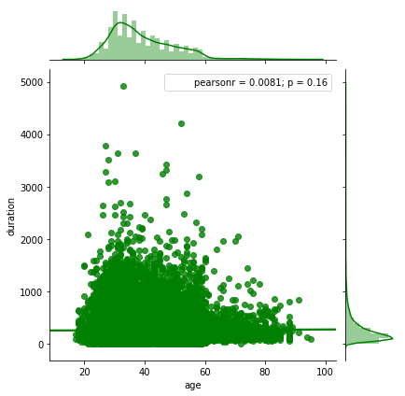
Age versus Duration

Slide 12
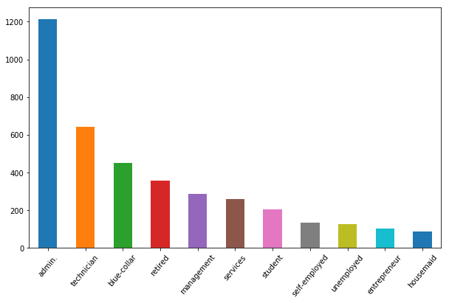
Subscriptions based on employment status

Slide 13
Technical Component

Slide 14
Models | Test set Accuracy score | Precision for Class 1 | F1 score | ROC-AUC
Baseline Accuracy | 0.538
Logistic regression | 0.838 | 0.44 | 0.86 | 0.872
Logistic regression (with tuning) | 0.837 | 0.44 | 0.86 | 0.871
Support Vector Machine | 0.847 | 0.46 | 0.87 | 0.865
Decision Tree | 0.866 | 0.49 | 0.88 | 0.832
Decision Tree (with tuning) | 0.866 | 0.49 | 0.88 | 0.830
Gradient Boosting | 0.865 | 0.49 | 0.88 | 0.871
Gradient Boosting (with tuning) | 0.861 | 0.48 | 0.88 | 0.870

Slide 15
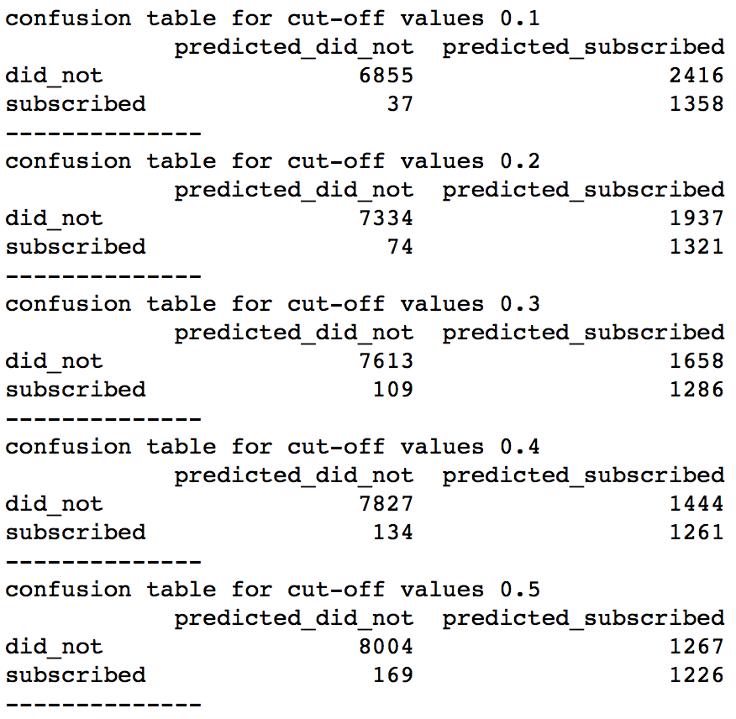
Confusion Matrix
for Adjusted
Cut-Offs

